Slide 1
Commodity Clusters

Slide 2
What is a Commodity Cluster?
It is a distributed/parallel computing system
It is constructed entirely from commodity subsystems
All subcomponents can be acquired commercially and separately
Computing elements (nodes) are employed as fully operational standalone mainstream systems
Two major subsystems:
Compute nodes
System area network (SAN)
Employs industry standard interfaces for integration
Uses industry standard software for majority of services
Incorporates additional middleware for interoperability among elements
Uses software for coordinated programming of elements in parallel

Slide 3
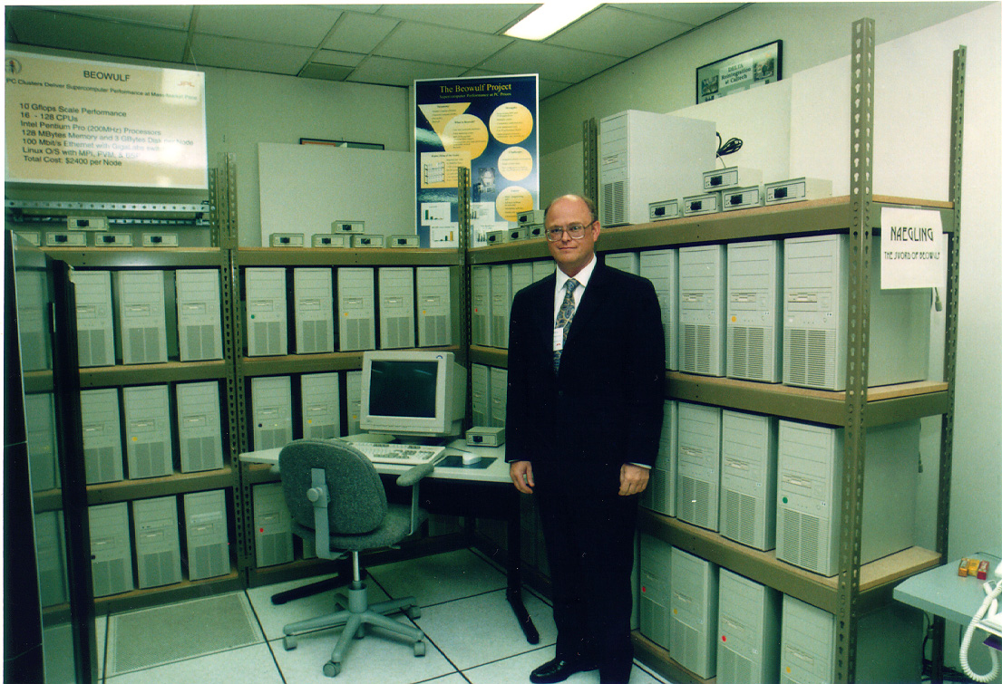
Notes:
Caltech 1997 Cost of a super computer dropped by about 50 fold (to 2% of previous cost) in roughly a decade

Slide 4
Commodity Clusters vs “Constellations”
p is greater than N
Distinction is which layer gives us the most power through parallelism
An ensemble of N nodes each comprising p computing elements
The p elements are tightly bound shared memory (e.g., smp, dsm)
The N nodes are loosely coupled, i.e., distributed memory
16X
16X
4X
4X
4X
4X
4X
4X
System Area Network
4X
4X
System Area Network
4X
4X
4X
4X
16X
16X
4X
4X
4X
4X
64 Processor Constellation

Slide 5
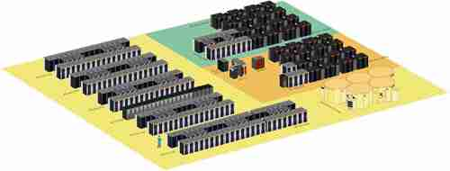
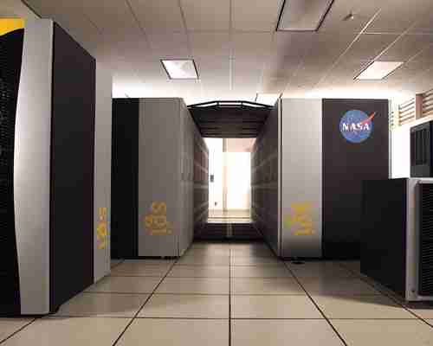
Columbia
NASA’s largest computer
NASA Ames Research Center
A Constellation
20 nodes
SGI Altix 512 processor nodes
Total: 10,240 Intel Itanium-2 processors
400 Terabytes of RAID
2.5 Petabytes of silo farm tape storage

Slide 6
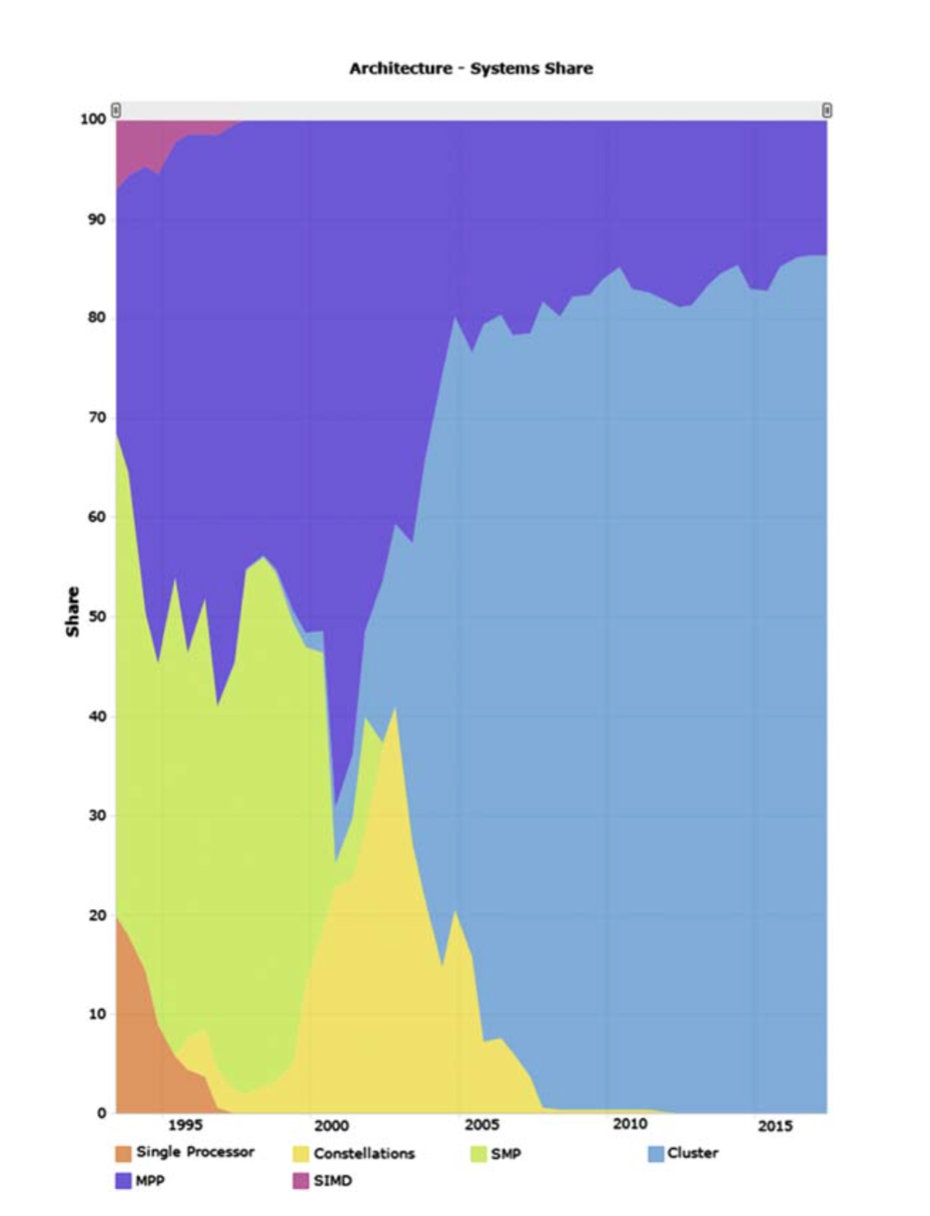
Clusters Dominate Top-500
The dominant system architecture classes comprising the fastest 500 computers over the last 24 years.

Slide 7
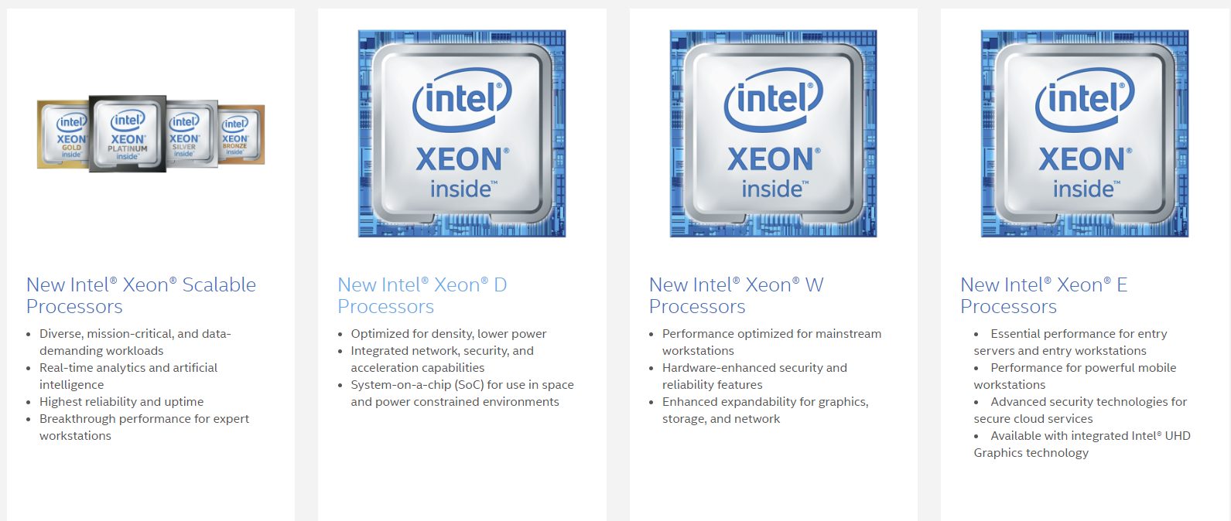
Notes:
By Sri source: https://www.intel.ca/content/www/ca/en/products/processors/xeon.html

Slide 8
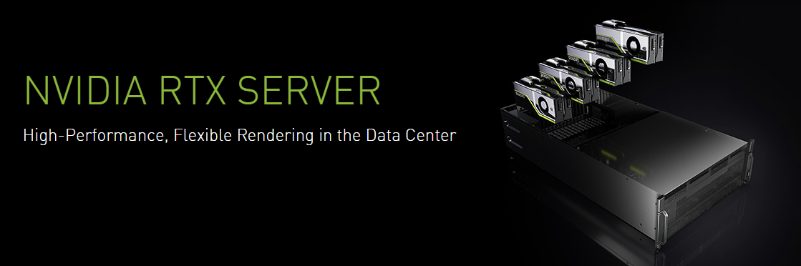
Notes:
https://www.nvidia.com/en-us/design-visualization/quadro-servers/rtx/

Slide 9
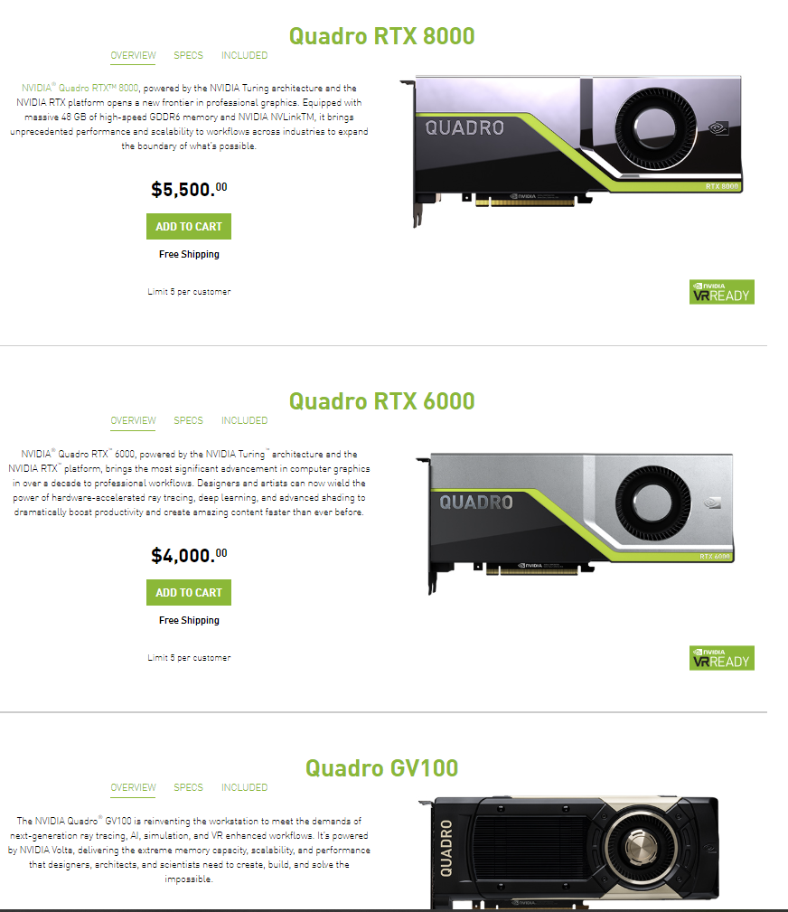
Notes:
https://www.nvidia.com/en-us/design-visualization/quadro-store/
GV100 is 9000 USD

Slide 10
Why are Clusters so Prevalent
Excellent performance to cost for many workloads
Exploits economy of scale
Mass produced device types
Mainstream standalone subsystems
Many competing vendors for similar products
Just in place configuration
Scalable up and down
Flexible in configuration
Rapid tracking of technology advance
First to exploit newest component types
Programmable
Uses industry standard programming languages and tools
User empowerment
Low cost, ubiquitous systems
Programming systems make it relatively easy to program for expert users

Slide 11
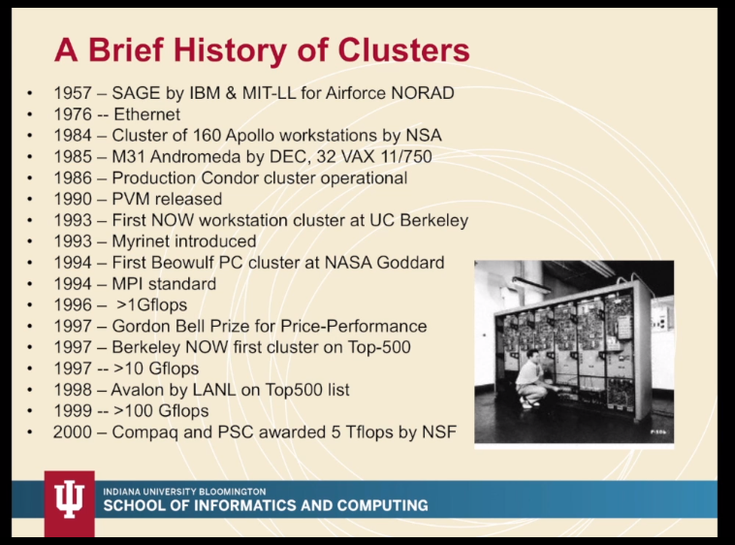
Notes:
Sage – for processing RADAR signals. It still ran on vacuum tubes
https://iu.mediaspace.kaltura.com/media/L3+Commodity+Clusters+%28Seg.+2%29.mp4/1_518ovpfd/65633621

Slide 12
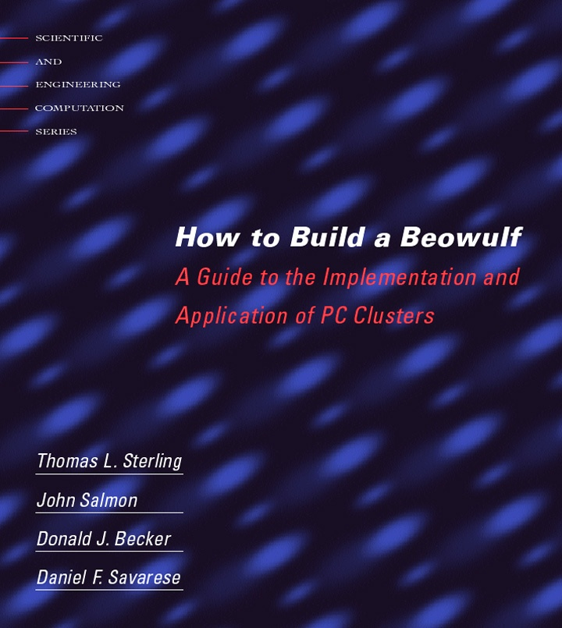
1st printing: May, 1999
2nd printing: Aug. 1999
MIT Press

Slide 13
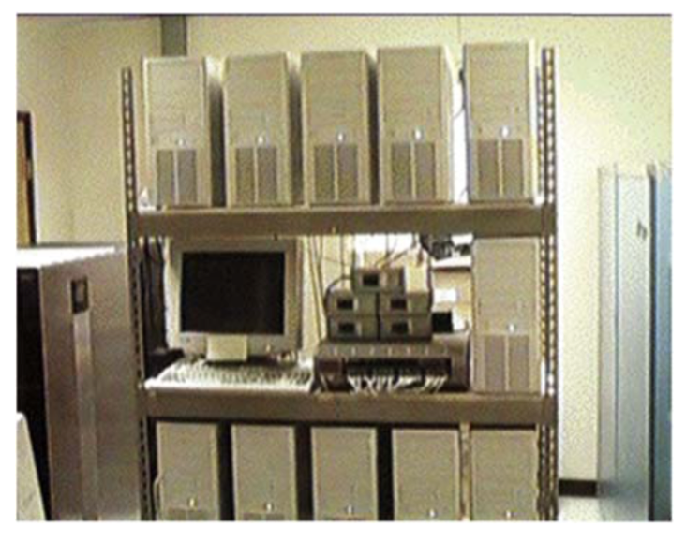
The 1996 1 Gigaflops Beowulf cluster.

Slide 14
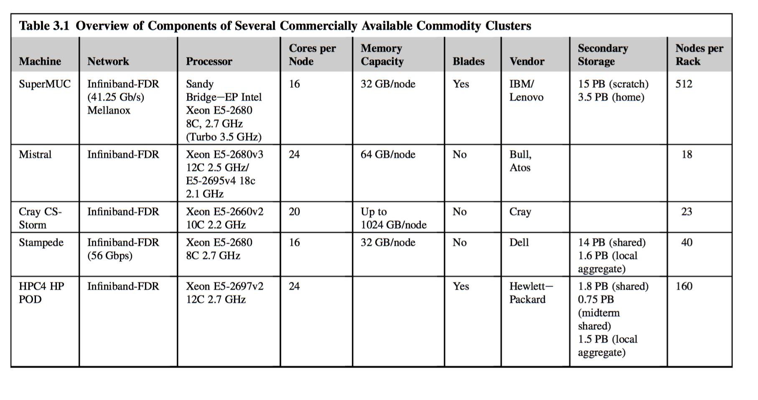

Slide 15
Programming on Clusters
Several ways of programming application on clusters
Throughput – jobstream
Decoupled Work Queue Model – SPMD for parameter studies
Communicating Sequential Processes (CSP)
Multi threaded
Throughput: job stream
PBS, Maui
Decoupled Work Queue Model : SPMD, e.g. parametric studies
Condor
Communicating Sequential Processes
Message passing
Distributed memory
Global barrier synchronization
e.g., MPI
Multi threaded
Limited to intra-node programming
Shared memory
e.g., OpenMP
Notes:
Include this

Slide 16
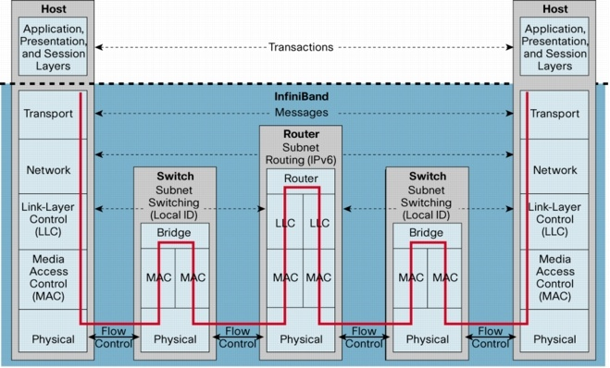
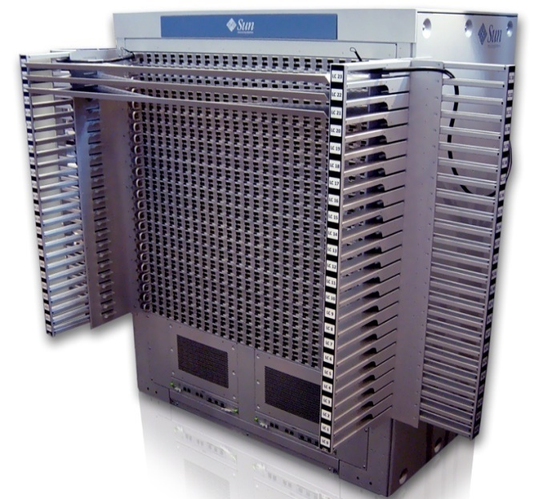
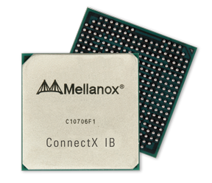
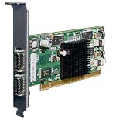
Some Node Interconnect Options
Current Generation
Gigabit Ethernet (~1000 Mb/s)
10 Gigabit Ethernet
40 Gigabit Ethernet and 100 Gigabt Ethernet (100GbE) standards are in draft as of 2009
Infiniband (IBA)
High Performance: 10 - 20 Gbps
Low latency: 1.2 microseconds
Copper interconnects
High availability - IEEE 802.3ad Link Aggregation / Channel Bonding
Previous Generation
Fast Ethernet (~100 Mb/s)
Myricom’s Myrinet-2000 (~1600 Mb/s)
SCI (~4000 Mb/s)
OC-12 ATM (~622 Mb/s)
Fiber Channel (~100 MB/s)
USB (12 Mb/s)
Firewire (IEEE 1394 400 Mb/s)

Slide 17
Schedulers: PBS
Workload management system – coordinates resource utilization policy and user job requirements
Multi users, Multi jobs, Multi nodes
Both Open Source and Commercially supported
Functionality
Manages parallel job execution
Interactive and batch cross system scheduling
Security and access control lists
Dynamic distribution and automatic load-leveling of workload
Job and user accounting
Accomplishments
Runs on all Unix and Linux platforms
Supports MPI
First release 1995
2000 sites registered, 1000 people on the mailing list
PBSPro sales at >5000 cpu’s
Notes:
This slide

Slide 18
MPI Software
Community wide standard process
Leveraged experiences with NX, PVM, P4, Zipcode, others
Dominant programming model for clusters
Multiple implementations both OSS and commercial (MPI Soft Tech)
All of MPI-1
MPI I./O
All of MPI-2
MPI-3 under development
Functionality
Message passing model for distributed memory platforms
Support for truly scalable operations (1000s nodes)
Rich set of collective operations (gathers, reduces, scans, all to all)
Scalable one sided operations (fence barrier synchronization, group-oriented synchronization)
Dynamic processes (2) to spawn, disconnect etc. with scalability
MPICH-2 entirely new rewrite
OpenMPI includes fault tolerant capability

Slide 19
Compilers & Debuggers
Compilers :
Intel C/ C++ / Fortran
PGI C/ C++ / Fortran
GNU C / C++ / Fortran
Libraries :
Each compiler is linked against MPICH
Mesh/Grid Partitioning software : METIS etc.
Math Kernel Libraries (MKL)
Intel MKL, AMD MKL, GNU Scientific Library (GSL)
Data format libraries : NetCDF, HDF 5 etc
Linear Algebra Packages : BLAS, LAPACK etc
Debuggers
Gdb – debugger for c++
Totalview
Performance & Profiling tools :
PAPI
TAU
Gprof
perfctr

Slide 20
Distributed File Systems
A distributed file system is a file system that is stored locally on one system (server) but is accessible by processes on many systems (clients).
Multiple processes access multiple files simultaneously.
Other attributes of a DFS may include :
Access control lists (ACLs)
Client-side file replication
Server- and client- side caching
Some examples of DFSes:
NFS (Sun)
AFS (CMU)
PVFS (Clemson, Argonne), OrangeFS
Lustre (Sun)
GPFS (IBM)
Distributed file systems can be used by parallel programs, but they have significant disadvantages :
The network bandwidth of the server system is a limiting factor on performance
To retain UNIX-style file consistency, the DFS software must implement some form of locking which has significant performance implications
Ohio Supercomputer Center
Notes:
File system

Slide 21
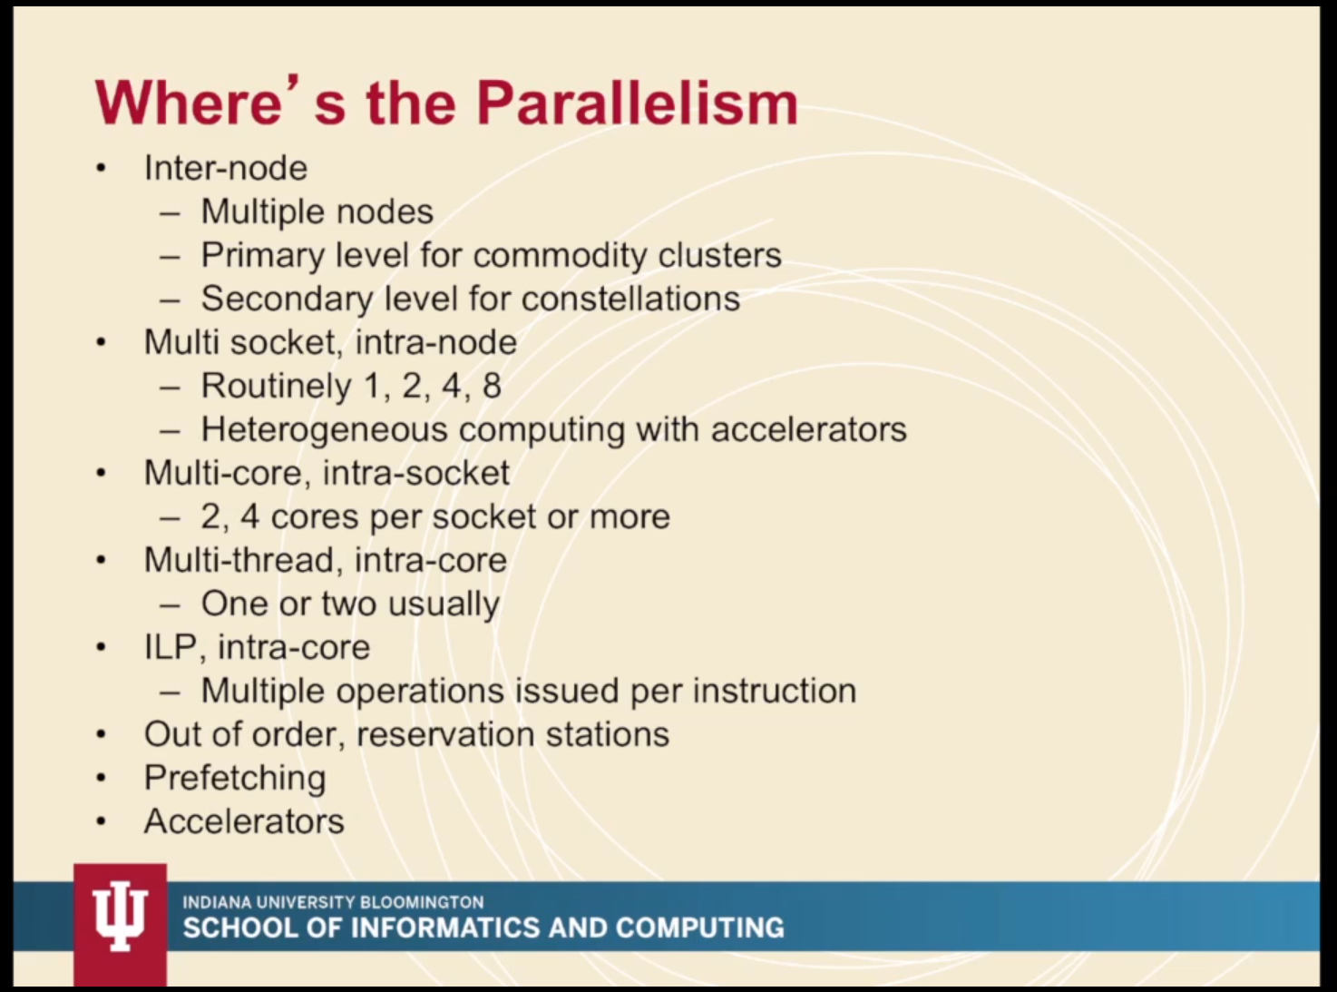
No more 8
1 and 2 -> AMD ; 4 -. Intel
Notes:
https://iu.mediaspace.kaltura.com/media/L3+Commodity+Clusters+%28Seg.+4%29/1_x6ldemqn/65633621

Slide 22
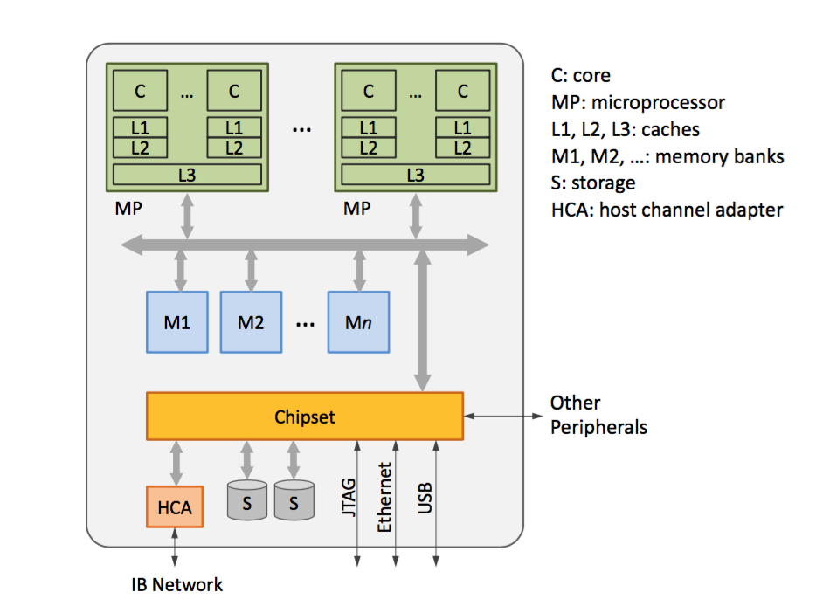
SMP Node Diagram
Notes:
HCA – Host channel adapter JTAG – joint test action group ( for verifying PCBs)
IB is infiband ( a network standard for HPC)

Slide 23
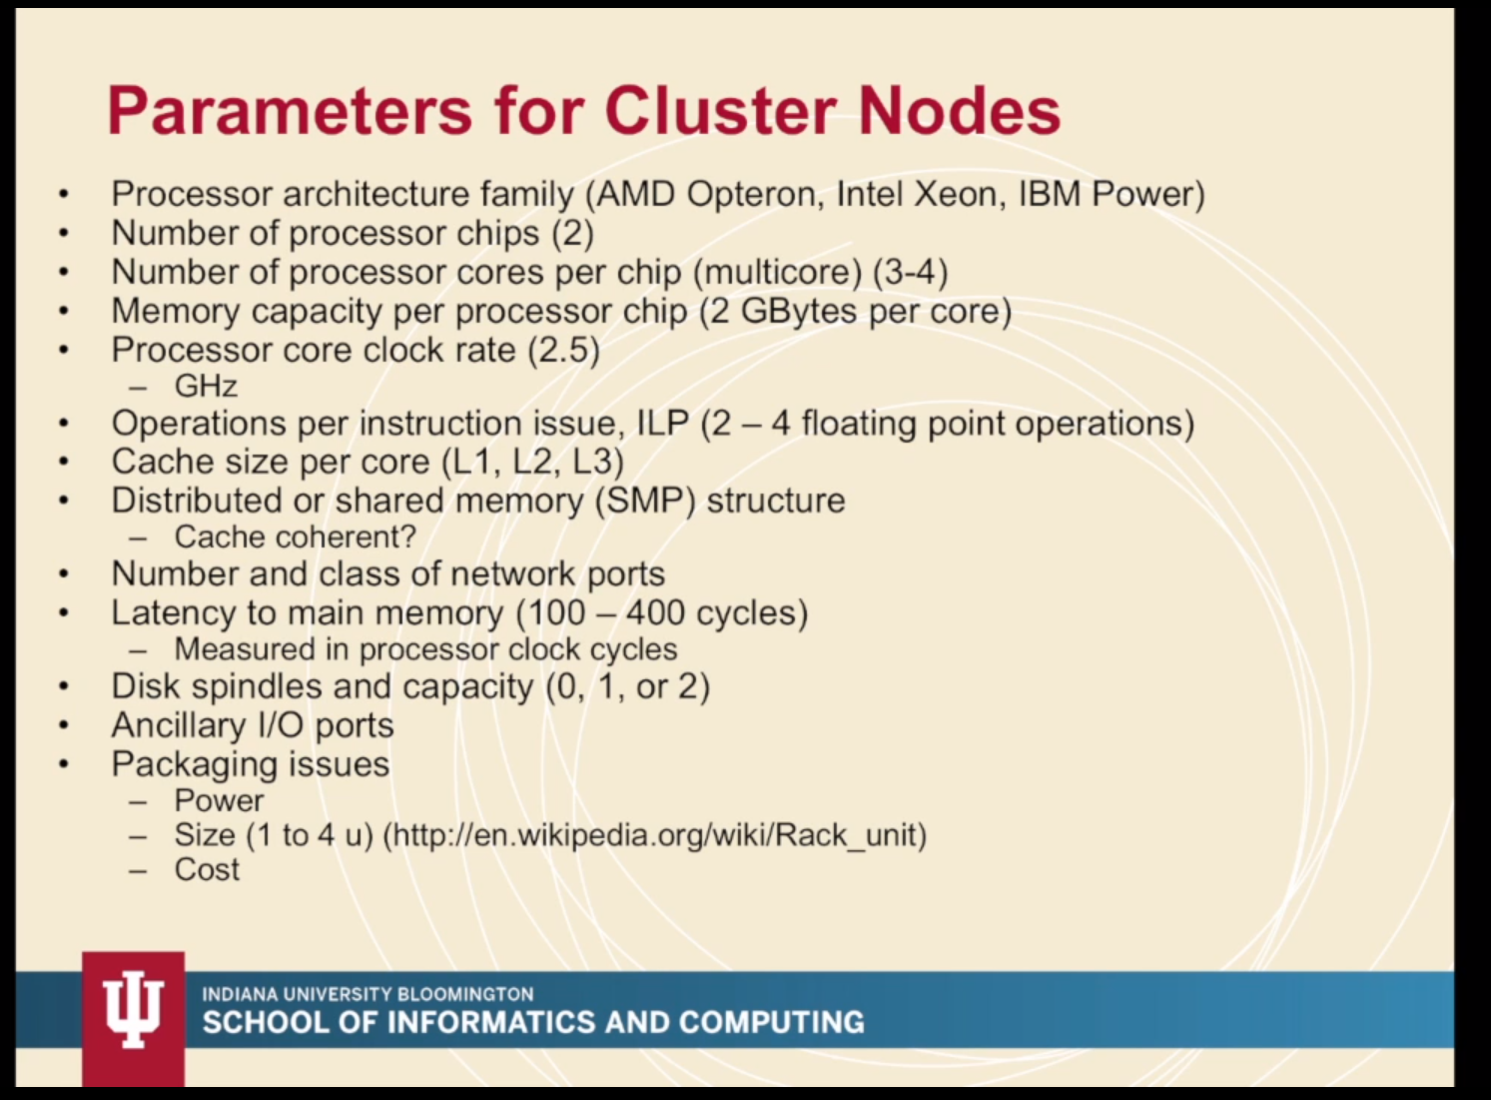

Slide 24
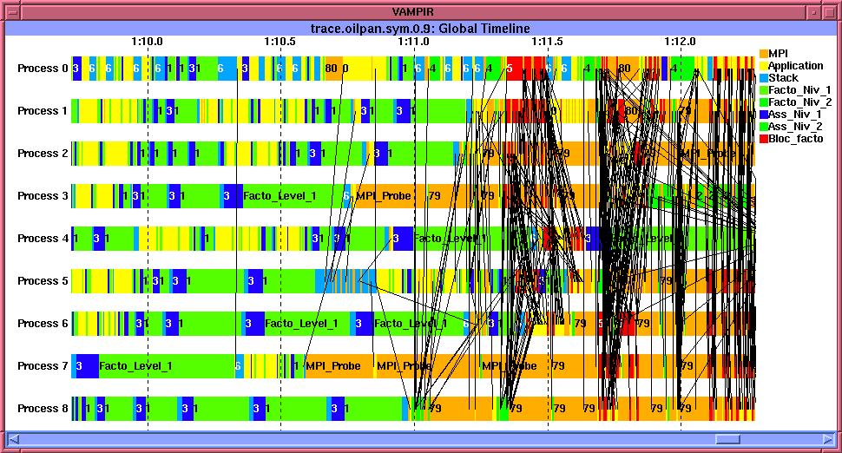
Measuring Performance on Clusters
Ways of measuring performance
Wall clock time
Benchmarks
Processor efficiency factors
Scalability
MPI communications and synchronization overhead
System operations
Tools
PAPI
Tau
Ganglia
Many others
Notes:
This slide

Slide 25
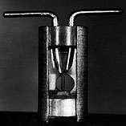

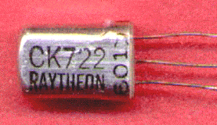
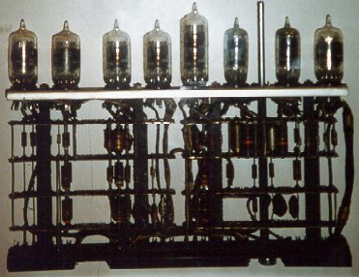
Open Source Software
Evolution of PC Clusters has benefited from Open Source Software
Early examples
Gnu compiler tools, FreeBSD, Linux, PVM
Advantages
Provides shared infrastructure – avoids duplication of effort
Permits wide collaborations
Facilitates exploratory studies and innovation
Free software is not necessarily OSS
Business model in state of flux: how to fund free deliverables
Important synergy between OSS standard infrastructure software and proprietary ISV target-specific software:
OSS provides common framework
For-profit software provides incentive and resources

Slide 26
The History of Linux
Started out with Linus' frustation on available affordable operating systems for the PC
He put together a rudimentary scheduler, and later added on more features until he could bootstrap the kernel (1991).
The source was released on the internet in hope that more people would contribute to the kernel
GCC was ported, a C library was added and a primitive serial and tty driver code
Networks, file systems were added
Slackware
RedHat
Extreme Linux

Slide 27
Linux Distributions
Alphanet Linux
Alzza Linux
Andrew Linux
Apokalypse
Armed Linux
ASPLinux
Bad Penguin
Bastille Linux
Best Linux
BlackCat Linux
Blue Linux
Bluecat Linux
BluePoint Linux
Brutalware
Caldera OpenLinux
Cclinux
ChainSaw Linux
CLEClIeNUX
Conectiva
CoolLinux
Coyote Linux
Corel
COX-Linux
Darkstar Linux
Debian Definite Linux
deepLINUX
Delix
Dlite (Debian Lite)
DragonLinux
Eagle Linux M68K
easyLinux
Elfstone Linux
Embedix
Enoch
Eonova Linux
ESware
Etlinux
Eurielec Linux
FinnixFloppi Gentoo Linux
Gentus Linux
Green Frog Linux
Halloween Linux
Hard Hat Linux
HispaFuentes
HVLinux
Icepack
Immunix OSIndependence
InfoMagick Workgroup Server
Ivrix
ix86 Linux
JBLinux
Jurix Linux
Kondara
Krud
KW Linux
KSI Linux
L13Plus
Laser5
Leetnux
Lightening
Linpus Linux
Linux Antarctica
Linux by Linux
Linux GT Server Edition
Linux Mandrake
Linux MX
LinuxOne
LinuxPPC
LinuxPPP
LinuxSIS
LinuxWare
Linux-YeS
LNX System
Lunet
LuteLinux
LST
Mastodon
MaxOS&trade
MIZI Linux OS
MkLinux
MNIS Linux
MicroLinux
Monkey Linux
NeoLinux
Newlix OfficeServer
NoMad Linux
Ocularis
Open Kernel Linux
Open Share Linux
OS2000
Peanut Linux
PhatLINUX
PingOO
Plamo Linux
Platinum Linux
Power Linux
Progeny Debian
Project Freesco
Prosa Debian
Pygmy Linux
Red Flag Linux
Red Hat Linux
Redmond Linux
Rock Linux
RT-Linux
Scrudge Ware
Secure Linux
Skygate Linux
Slacknet Linux
Slackware
Slinux
SOT Linux
Spiro
Stampede Linux
Storm Linux
S.u.SE
Thin Linux
TINY Linux
Trinux
Trustix Secure Linux
TurboLinux
Turquaz
UltraPenguin
Ute-Linux
VA-enhanced RedHat Linux
VectorLinux
Vedova Linux
Vine Linux
White Dwarf Linux
Whole Linux
WinLinux 2000
WorkGroup Solutions
Linux Pro Plus
Xdenu
Xpresso Linux 2000
XTeam Linux
Yellow Dog Linux
Yggdrasil Linux
ZiiF Linux
ZipHam
ZipSlack

Slide 28
The OS
The OS manages the hardware for and with the user

Slide 29
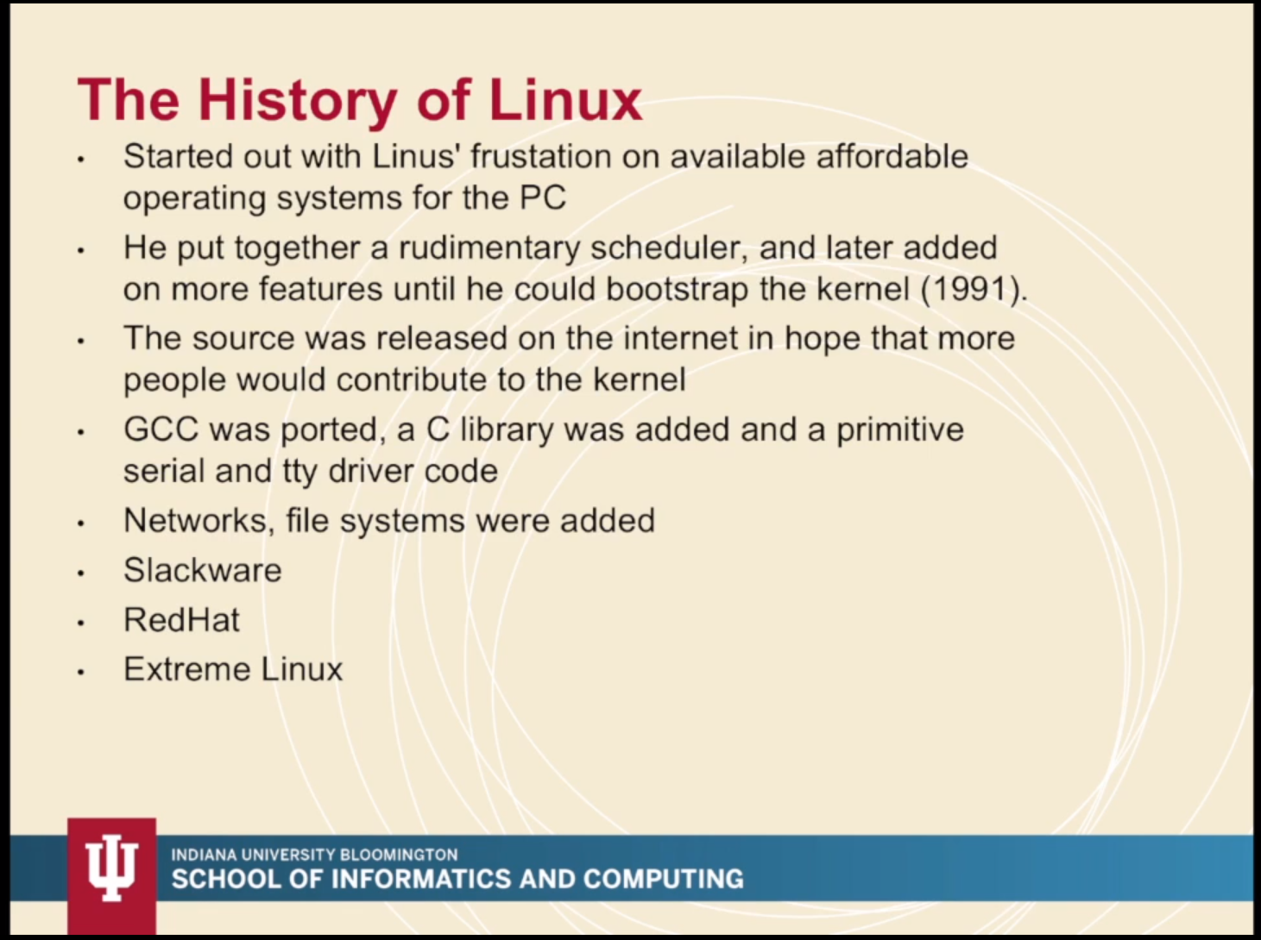

Slide 30
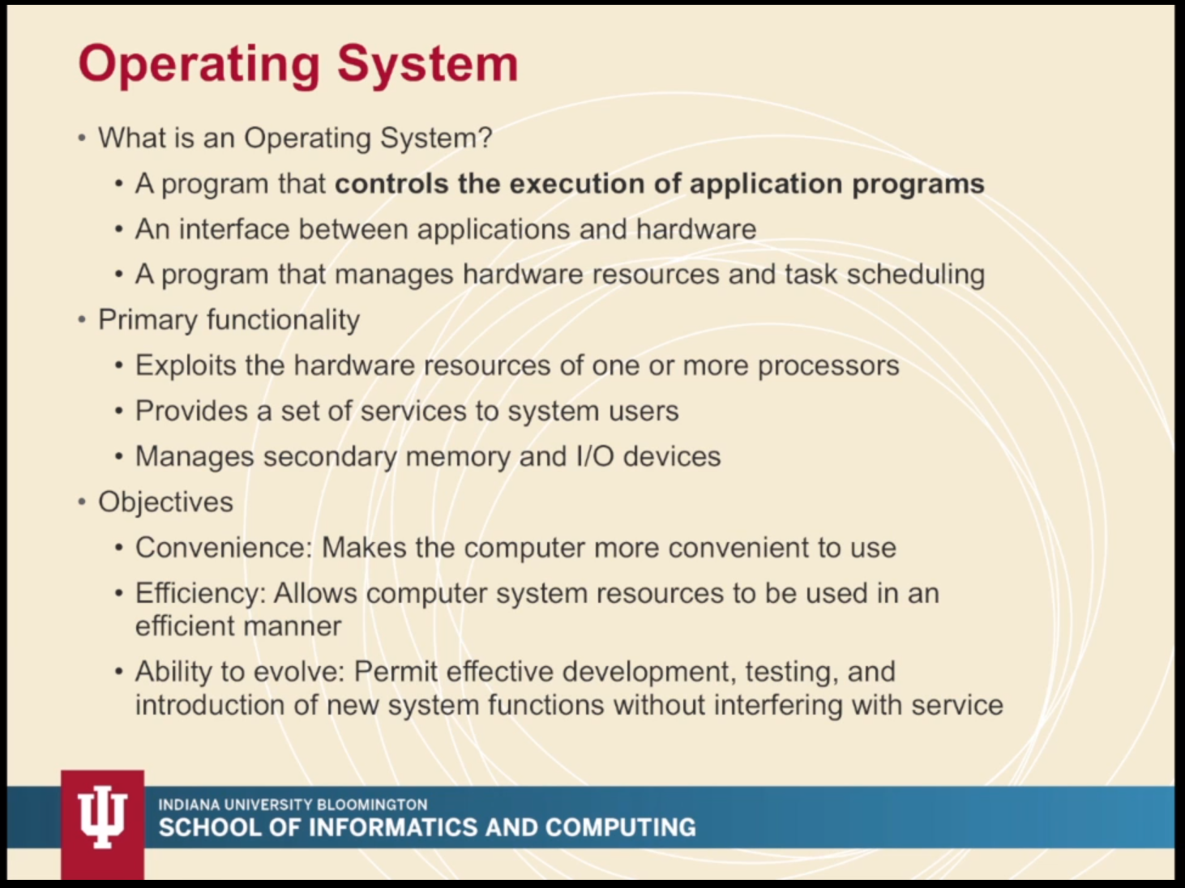

Slide 31
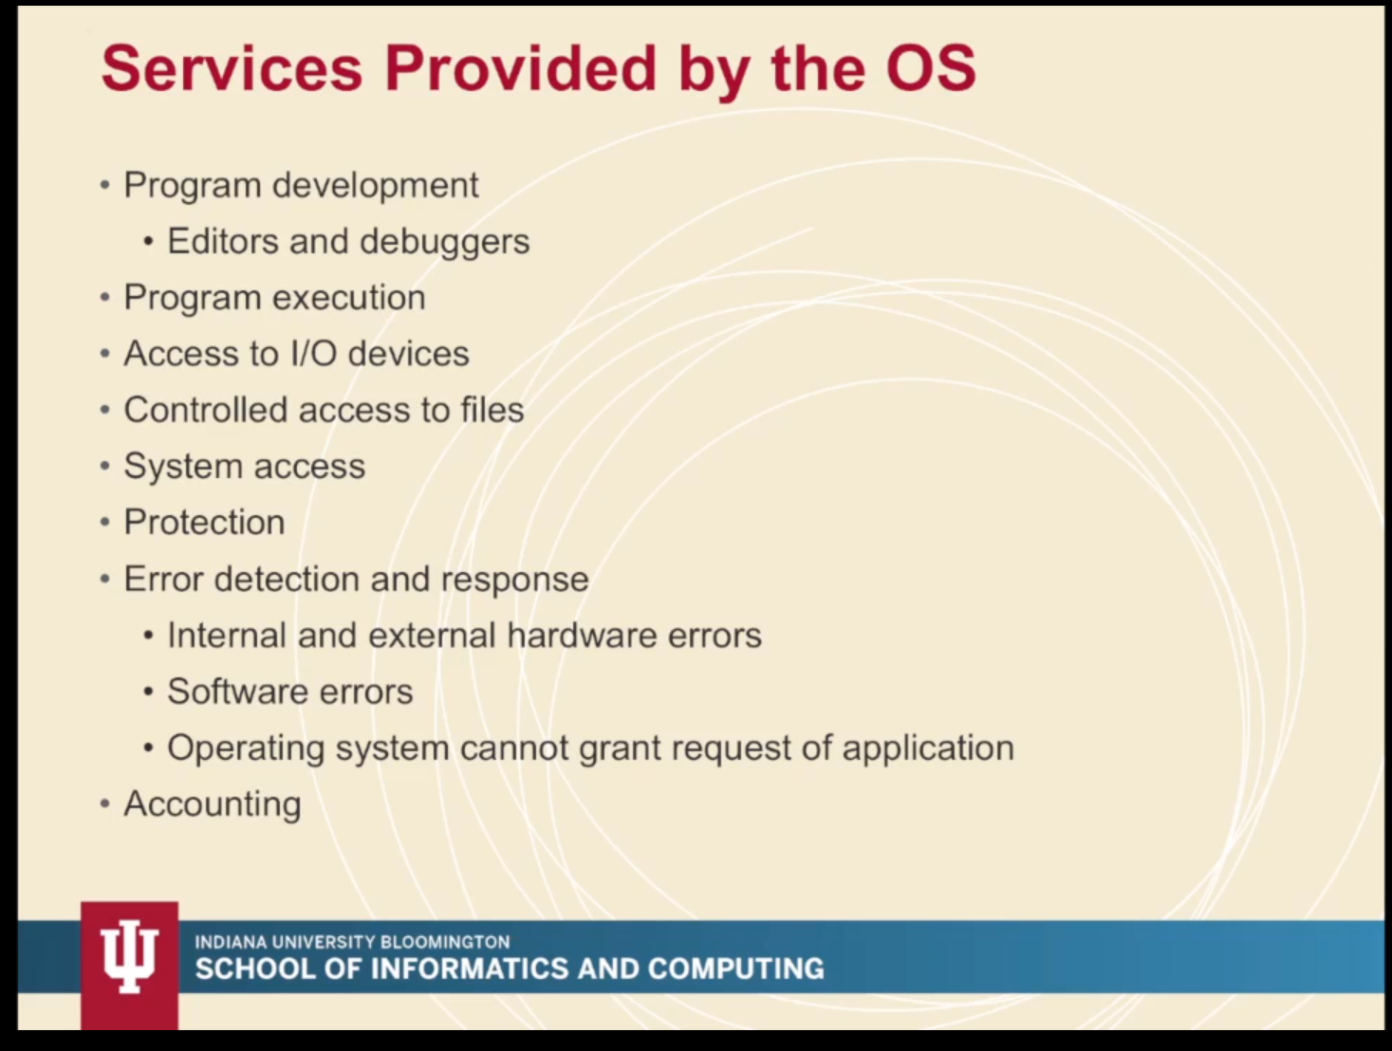

Slide 32
Benchmarking

Slide 33
Benchmarking
Benchmarking is a way to empirically measure the performance of a supercomputer.
A benchmark provides some standardized type of workload that may vary in size or input data set.
Benchmarks provide as output a performance metric that can be used for comparing the performance between different supercomputers based on that benchmark’s specific workload.
Some example performance metrics: floating point operations per second (Flops), traversed edges per second (Teps), Giga updates per second (Gups), degrees of freedom per second (Dofs).
Computational benchmark workloads come in two types: synthetic, where workloads are designed and created to impose a load on a specific component in the system; and application, where the workload is derived from a real-world application.

Slide 34
Historical Benchmarking Efforts
Whetstone benchmark named after the Whetstone village in Leicestershire England
This benchmark, first released in 1972, consisted of multiple programs that created synthetic workloads for evaluating Kilo Whetstone Instructions per second.
Benchmark is floating point intensive.
In 1980 it was updated to report floating point operations per second.
Can still be downloaded: www.netlib.org/benchmark

Slide 35
Historical Benchmarking Efforts
Dhrystone -- a benchmark with a standardized synthetic computing workload for measuring integer performance.
Name reflects its function as the integer counterpart to Whetstone.
This benchmark, like Whetstone, would become an industry standard.
Superseded by the SPECint suite.
Still downloadable: www.netlib.org/benchmark

Slide 36
LINPACK
The genesis of one of the most widely used benchmarks in supercomputing is the Linpack benchmark introduced by Jack Dongarra in 1979 and based on the Linpack linear algebra package developed by Jack Dongarra, Jim Bunch, Cleve Moler, and Gilbert Stewart .
The Linpack linear algebra package has been superseded by LAPACK but the Linpack benchmark is going strong.
The Linpack benchmark employs a workload that solves a dense system of linear equations. That is, it solves for x in Ax=b
where b and x are vectors of length n and A is an n x n matrix with very few or no zero elements.

Slide 37
LINPACK
The original Linpack benchmark solved matrices with n=100 and was written for serial computation.
No changes to the source code were allowed; only optimizations achieved through compiler flags were allowed.
A second iteration of the benchmark used matrices with n=1000 and allowed user modifications to the factorization and solver portions of the code. An accuracy bound on the final solution was also introduced.
The third iteration of the benchmark, called the Highly Parallel Computing Linpack or HPL, allows variations in the both the problem size and software and will run on a distributed memory supercomputer.
This version of the benchmark is used to generate the Top500 list that is frequently used to rank supercomputers throughout the world.

Slide 38
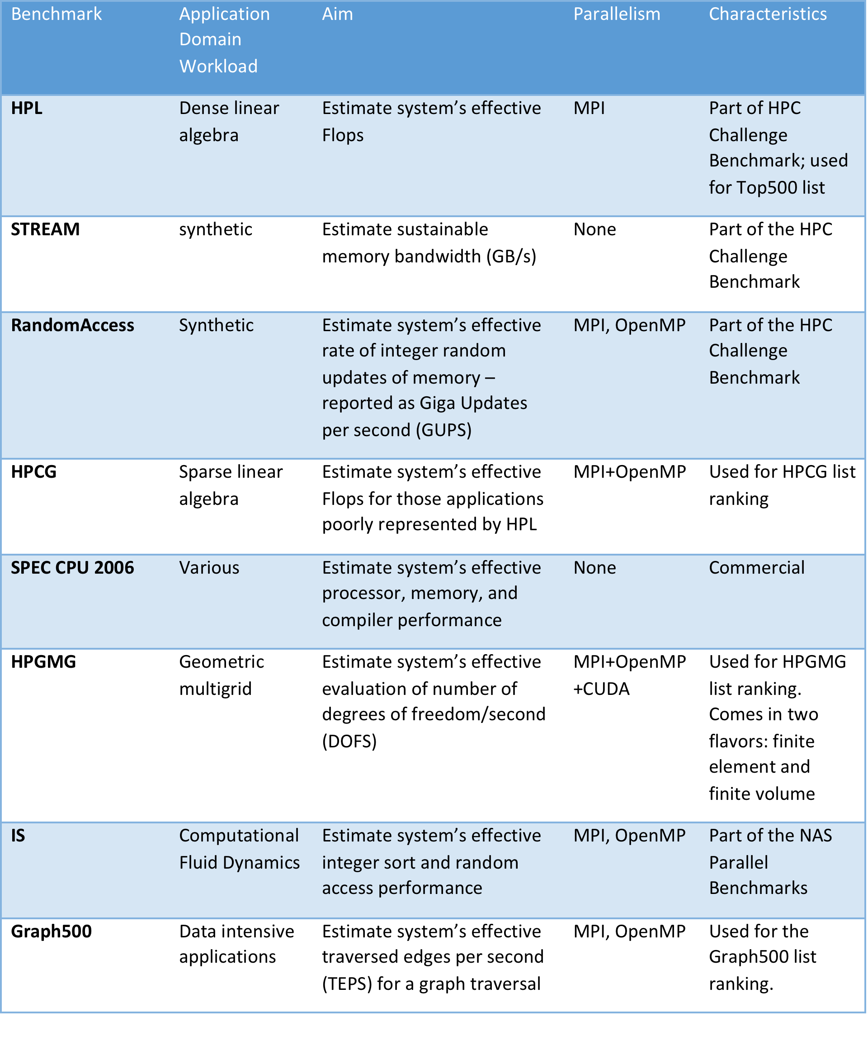
Today there are a wide variety of general-purpose benchmarks used for evaluating the performance of supercomputers and supercomputing elements. Many are motivated by specific classes of application workloads.

Slide 39
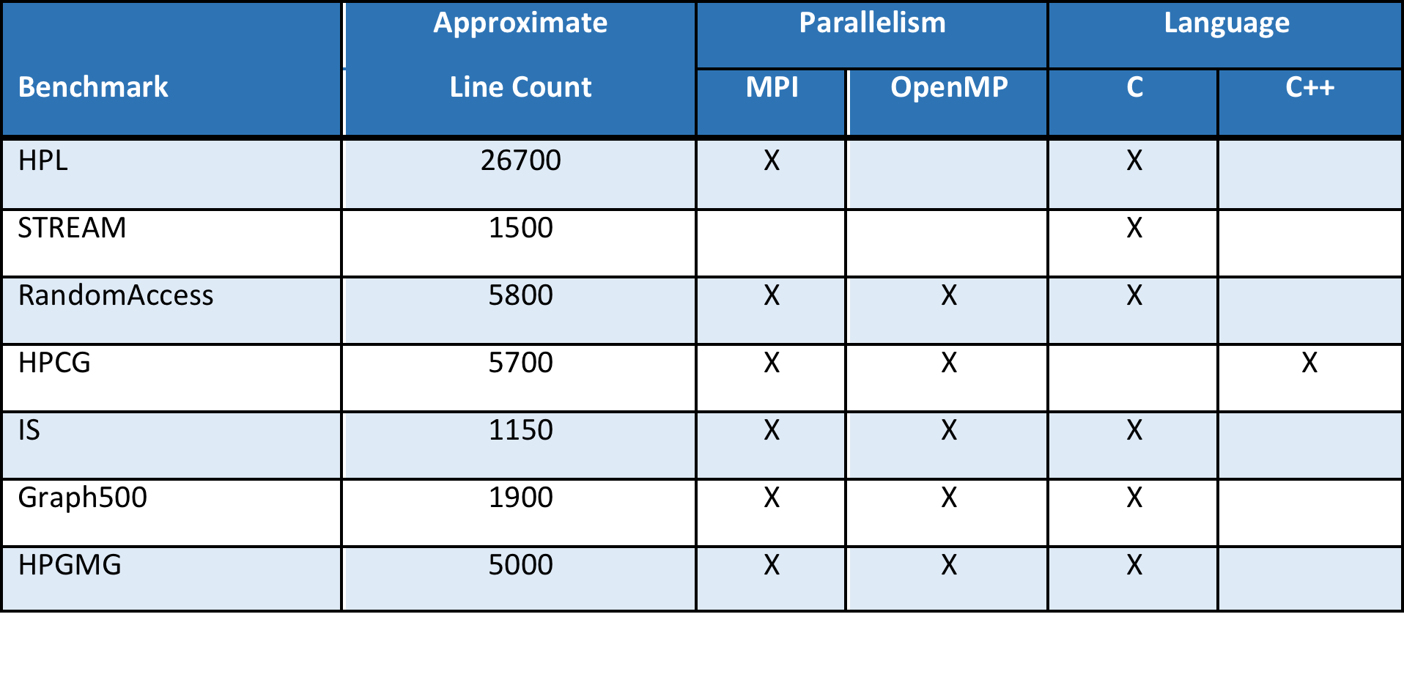
Key properties of an HPC Benchmark
A good benchmark is:
Relevant and meaningful to the target application domain.
Applicable to a broad spectrum of hardware architectures.
Adopted both by users and vendors and enable comparative evaluation.
Good benchmarks also tend to be relatively short and use standard parallel programming API’s

Slide 40
Because a supercomputer’s performance can be compared and ranked based entirely off of a single benchmark, multiple differing supercomputing performance rankings exist. Here are the top machines for four different lists:
Top500, Top HPCG, Graph500, and Top HPGMG for June 2017
Benchmark | Supercomputer | Location | Performance Result | Cores
HPL | Sunway TaihuLight | Jiangsu, China | 93.0 Petaflops | 10,649,600
HPGC | K computer | Kobe, Japan | 0.6027 Petaflops | 705,024
Graph500 | K computer | Kobe, Japan | 38621.4 GTEPS | 705,024
HPGMG | Cori | Berkely, CA, USA | 859 GigaDOFS | 632,400
A supercomputer that performs well on one benchmark may not do so well on another:
Supercomputer | Top500 List Ranking | Graph500 List Ranking | HPCG Ranking | HPGMG Ranking
Sunway Taihu Light | 1 | 2 | 3 | 2
Tianhe-2 | 2 | 8 | 2
K Computer | 8 | 1 | 1
Cori | 6 |  | 6 | 1

Slide 41
HPC Challenge Benchmark Suite
Consists of seven different tests:
HPL: LU factorization of dense linear algebra
DGEMM : double precision matrix-matrix multiplication
STREAM : synthetic workload to measure sustainable memory bandwidth
PTRANS : parallel matrix transpose
RandomAccess : reports the rate of integer random updates of memory in Giga-updates per second (GUPS)
FFT : double precision complex 1-D discrete Fourier transform
b_eff : reports the latency and bandwidth for several different communication patterns

Slide 42
HPL (high performance linpack)
Key workload algorithm is LU factorization
Given a problem size n, HPL will perform O(n³) floating point operations while only performing O(n²) memory accesses. Consequently, HPL is not strongly influenced by memory bandwidth.
HPL contains many possible variations in the way it is executed so that the best performing approach for a particular supercomputer can be found empirically.
The user is also allowed to entirely replace the LU factorization and solver step reference implementation with an alternative implementation if so desired.
Unlike the earlier versions of Linpack, there are no restrictions on problem size in HPL.
Notes:
LU – Lower – upper decomposition (a type of matrix factorization)

Slide 43
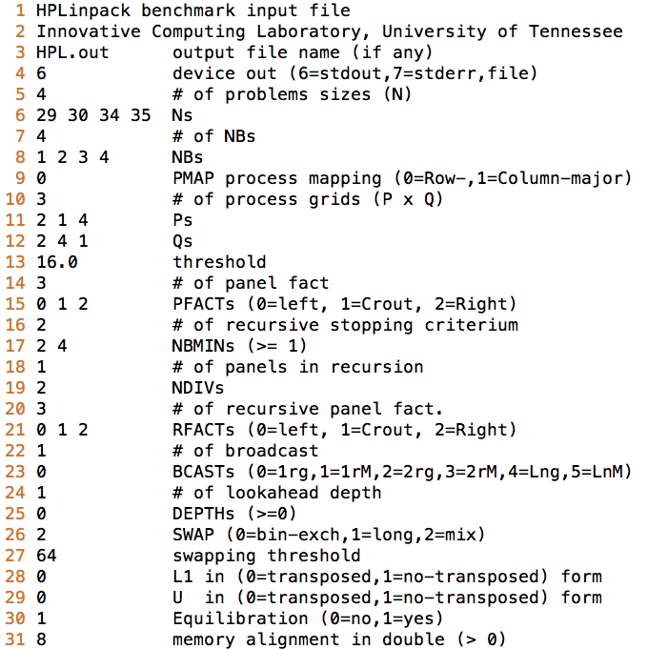
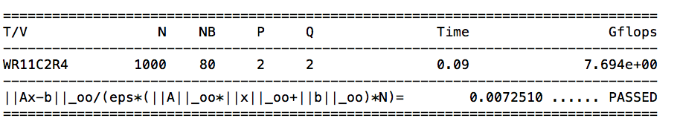
Running HPL/Linpack
The parameter space for tuning HPL is very large so parameter inputs separated by a space on each line are run independently.
Lines 5-13 specify problem sizes, block size configurations, grid configurations, and residual thresholds.
Lines 14-31 specify algorithmic variations in HPL. HPL has a number of different algorithm options, including 6 different virtual panel broadcast topologies (line 23), a bandwidth reducing swap-broadcast algorithm (line 26), back substitution with look-ahead depth of one (line 24), and three different LU factorization algorithms (lines 21) among other options.
Tuning for these parameters on a specific supercomputer is a routine task with HPL.
Example HPL input file
Example HPL output

Slide 44
Running HPL/Linpack
For a certain problem size N_{max}, the cumulative performance in Gflops reaches its maximum value called R_{max}.
The R_{max} value is what is reported for the Top500 list ranking supercomputers.
Another interesting metric from the HPL benchmark is N_{1/2}. N_{1/2} is the problem size where the maximum performance achieved is R_{max}/2.

Slide 45
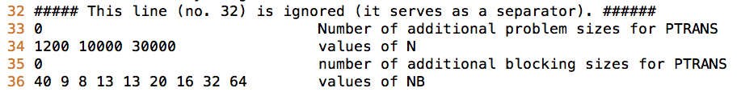
Running HPC Challenge Benchmark
HPC Challenge benchmark runs all seven benchmarks at once using the parameter file from HPL augmented by 5 lines:
Output from each of the seven benchmarks appears in the summary output

Slide 46
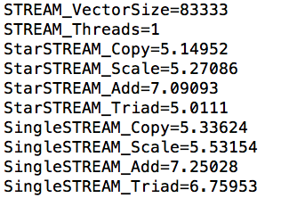
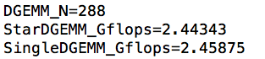
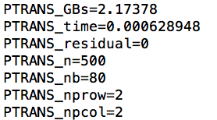
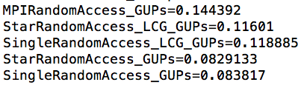
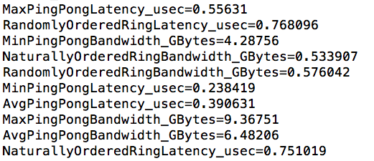
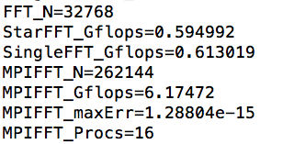
HPC Challenge Benchmark Output
DGEMM output
STREAM output
PTRANS output
RandomAccess output
FFT output
b_eff output

Slide 47
HPCG Benchmark
Developed by Jack Dongarra (HPL), Michael Heroux, and Piotr Luszczek (HPL)
Aims to complement HPL in exploring memory and data access patterns in application workloads that are not well represented by HPL
The workload in HPCG centers on a sparse system of linear equations , i.e. solve Ax = b where A is dominated by zero entries
Workload arises from the discretization of a three dimensional Laplacian partial differential equation with a 27 point stencil.
For problem size n, HPCG performs O(n) floating point operations while also requiring O(n) memory accesses.
HPCG, like HPL, reports Flops

Slide 48
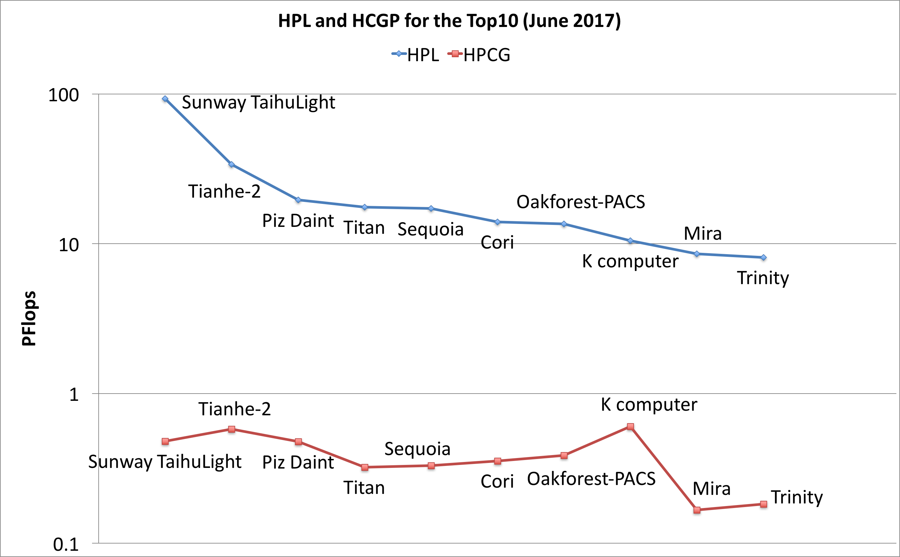
HPCG Benchmark for Top10 compared to HPL
HPCG only achieves a small fraction of the HPL Flops in to Top10

Slide 49
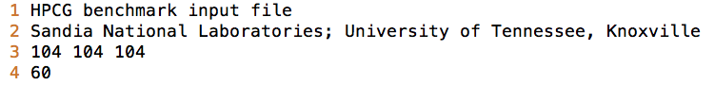
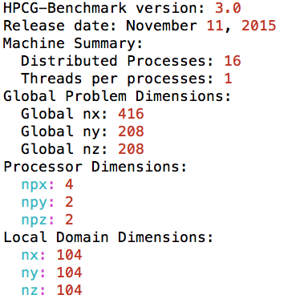
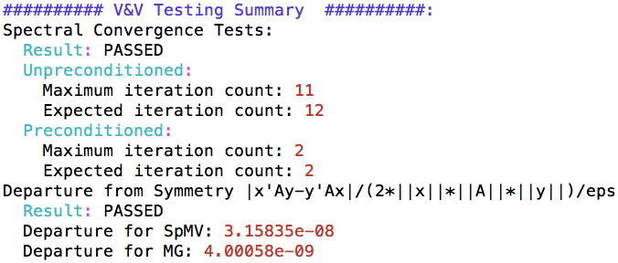
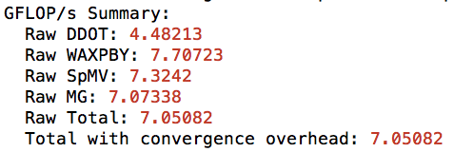
Running HPCG
Simple parameter file:
line 3 specifies the local process cubic grid size
line 4 gives the runtime in seconds
The output includes the global problem size along with V & V
And a final performance summary for each kernel

Slide 50
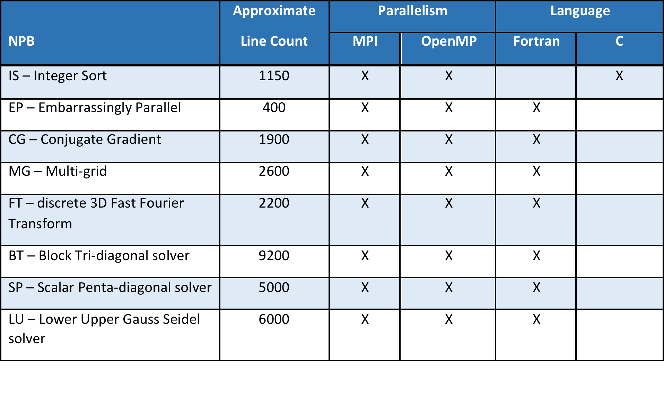
NAS Parallel Benchmarks (NPB)
The NAS parallel benchmarks (NPB) are a series of small self-contained programs that encapsulate the performance attributes of a large computational fluid dynamics application

Slide 51
NAS Parallel Benchmarks (NPB)
NPB originates from the NASA Ames research center in 1991
The first version of the benchmark consisted of eight problems that were specified entirely in a “pencil and paper” fashion. That is, there was no reference implementation as in other benchmarks and the benchmark was specified algorithmically.
In 1995, the second version of NPB was announced where reference versions based on MPI and Fortran77 would be distributed.
Subsequently, a third version of NPB was released which included a number of additions to the original eight problems as some additional parallel programming API’s beyond MPI such as OpenMP, High Performance Fortran, and Java.
Notes:
NAS – Nasa advanced supercomputing
Fluid dynamics stuff

Slide 52
NAS Parallel Benchmarks (NPB): the eight original problems
IS: large integer sort for testing both integer computation speed and network performance
EP: embarrassingly parallel random number generation for integral evaluation
CG: a conjugate gradient approximation to compute the smallest eigenvalue of a sparse symmetric matrix
MG: a multigrid solver for computing a 3-D potential
FFT: a time integrator of a 3-D partial differential equation using the Fast Fourier Transform
BT: a block tri-diagonal solver with a 5 x 5 block size
SP: a penta-diagonal solver
LU: An LU solver for coupled parabolic/elliptic partial differential equations.

Slide 53
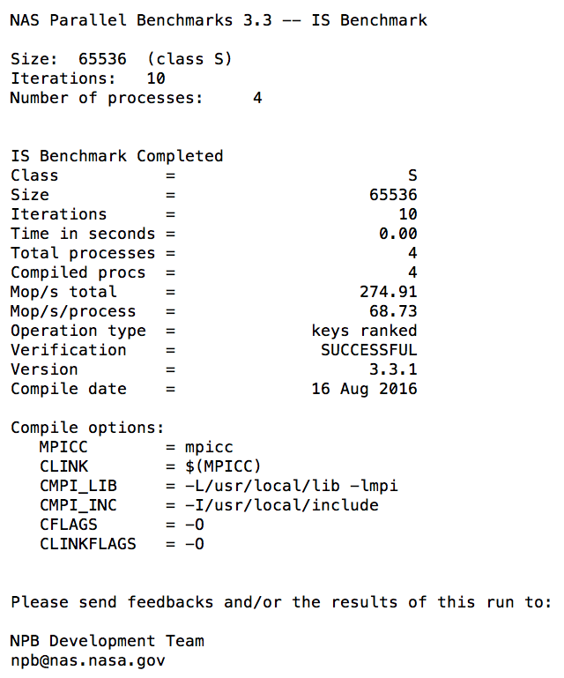
Running NPB
Output from NPB IS on 4 processes
The number of processes on which the benchmark runs is specified at compile time.
The problem class is specified at compile time. One of 7 options: S,W,A,B,C,D, or E. W indicates a problem for a 1990’s era workstation; A, B, C indicate standard problem sizes increasing by a factor of 4 with each letter; D and E indicate large test problems increasing by a factor of 16 by each letter.

Slide 54
Graph500 Benchmark
The graph500 benchmark was announced in 2010 and is intended to represent data intensive workloads rather than floating point intensive computations as in HPL.
Supported by an international steering committee of over 50 members and led by Richard Murphy (Micron)
The graph500 benchmark targets three key problems in the context of data intensive applications: concurrent search, the single source shortest path, and the maximal independent set.
At present, only the concurrent search problem has been specified as graph500 benchmark 1 and is sometimes also referred to as the graph500 benchmark.
The graph500 search benchmark implements the breadth-first search algorithm on a large graph.

Slide 55
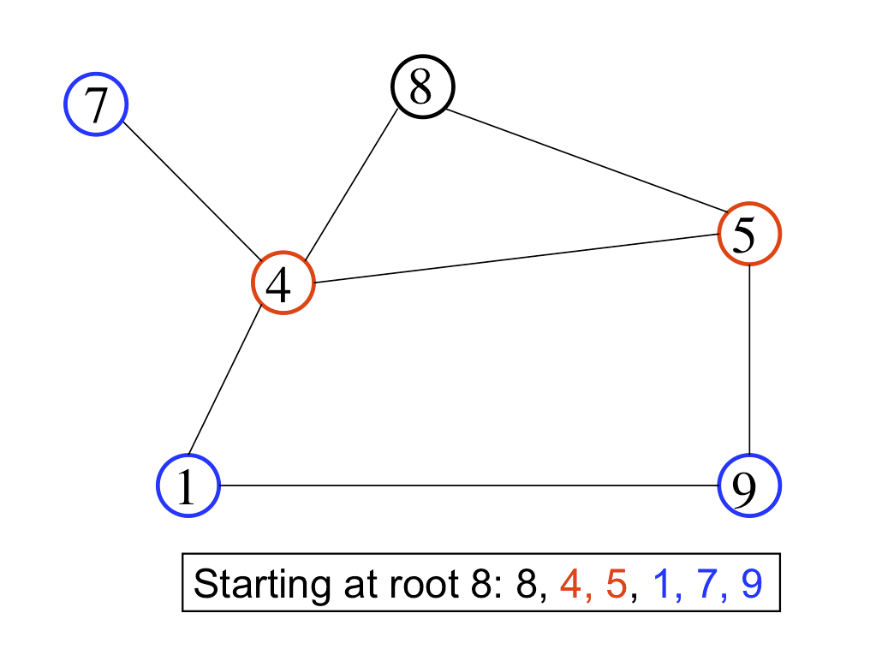
Graph500 Benchmark: Breadth-first search
Example of the breadth-first search traversal of this graph data structure starting at vertex 8. The starting vertex is also called the root. The adjacent vertices to the root are 4 and 5, colored red. The adjacent vertices to those are 1, 7, and 9, colored blue. Lines connecting the vertices are called edges

Slide 56
Graph500 Benchmark 1: Search
The benchmark starts with a root and finds all reachable vertices from that root
64 unique roots are checked.
There is only one kind of edge and there are no weights between vertices.
The output performance metric is traversed edges/second or TEPS.
The resulting search tree is validated to ensure it is the correct tree given the root.
The graph construction and the graph search are both timed in the graph500 search benchmark.
The reference implementation may be downloaded from www.graph500.org.
No external libraries or dependencies are needed.

Slide 57
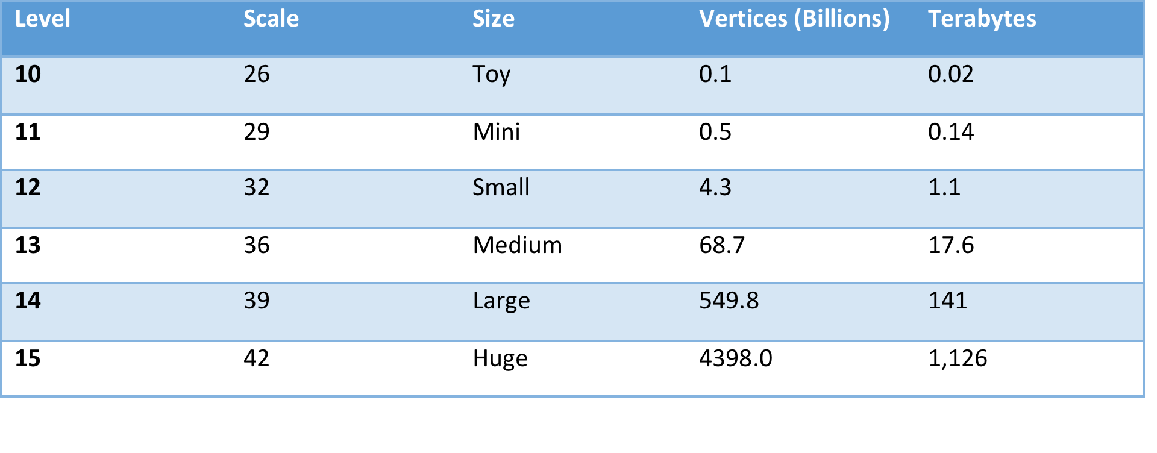
Graph500 Benchmark 1: Search
The graph500 benchmark requires at least one input to run and can take a second input. The usage for the benchmark shown
The first input supplies the code with the number of vertices:
The number of edges is given by the product of the number of vertices and the edgefactor (the second benchmark argument)
Problem sizes in the graph500 search benchmark are classified into six categories: toy, mini, small, medium, large, and huge. These are also referred to as levels 10-15 with level 10 toy and level 15 huge.

Slide 58
Graph500 Benchmark 1: Search
Problem sizes in the graph500 search benchmark are classified into six categories: toy, mini, small, medium, large, and huge. These are also referred to as levels 10-15 with level 10 toy and level 15 huge.

Slide 59
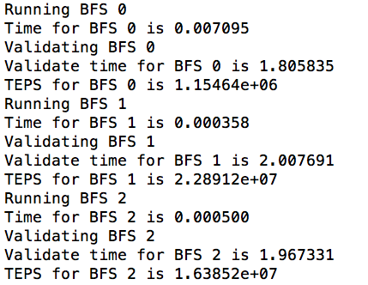
Running the graph500 benchmark
First, the timing output for the graph generation and construction will be printed to screen
Afterwards, the timing for the breadth-first search kernel will print to screen for each of the 64 roots followed by a validation phase, shown partially here

Slide 60
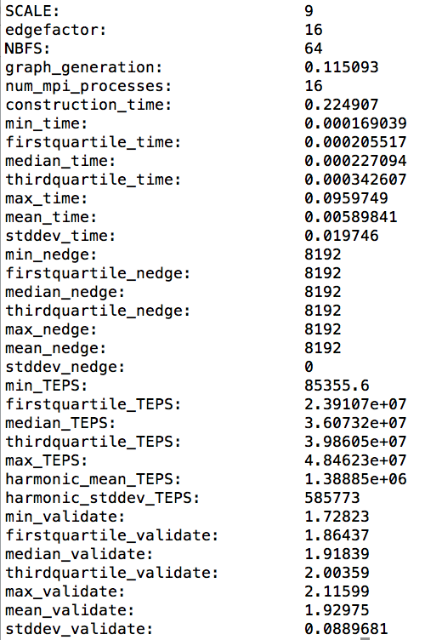
Running the graph500 benchmark
At the end of the graph traversal for each of the 64 roots, the final statistics for the graph500 search benchmark will print to screen
The graph500 search benchmark does not output Flops but rather TEPS

Slide 61
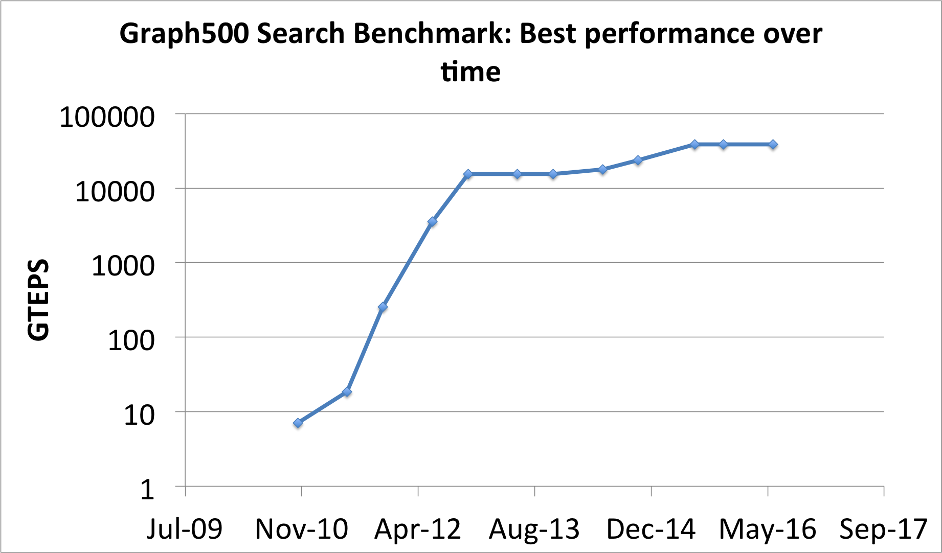
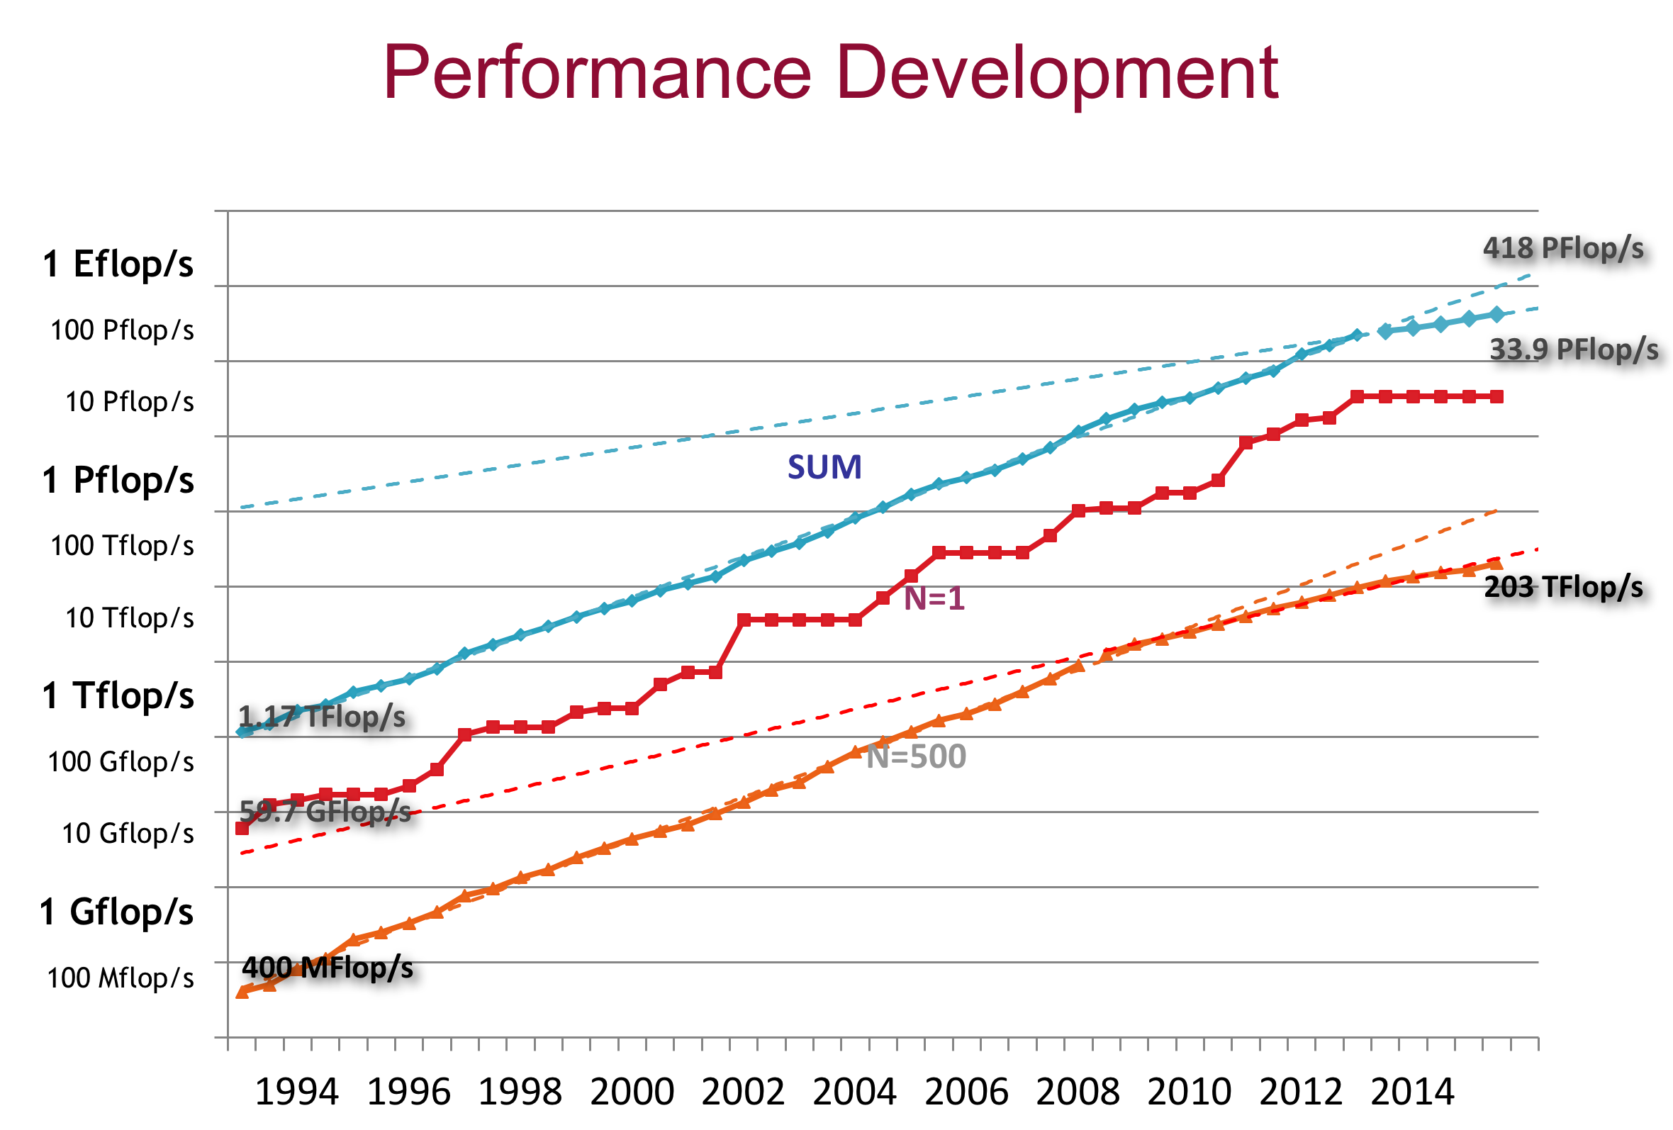
Graph500: Observation 1
While the HPL benchmark continues to show exponential improvement on newer supercomputers, the graph500 search benchmark performance has gone flat.

Slide 62
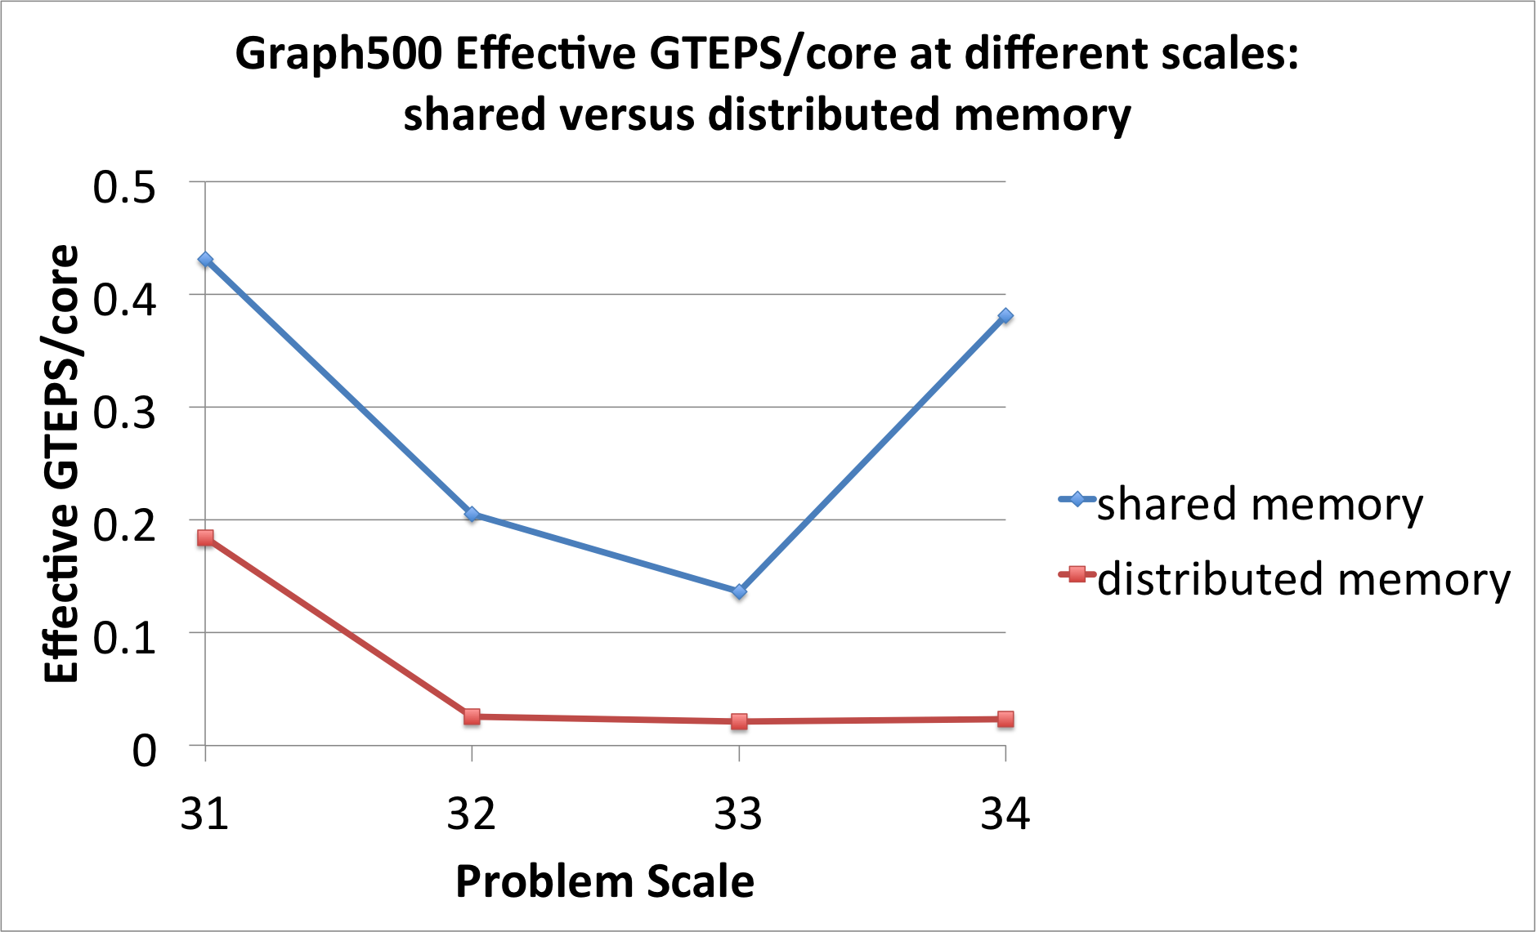
Graph500: Observation 2
The effective GTEPS/core is much lower for distributed memory architectures than for shared memory.

Slide 63


Slide 64
Mini-applications
Many argue that the HPC benchmarks are too simple in order to properly assess a supercomputer’s performance with respect to a dynamic application
To complement HPC benchmarking efforts and better capture real application behavior, many in the HPC community have turned to using mini-applications.
Like the name implies, mini-applications are smaller versions of real applications
They originate from a large number of scientific disciplines and are generally much longer than HPC benchmarks
They do not generally output any standardized metric like Flops, GUPS, TEPS, or DOFS but do provide time to solution for various kernels as well as strong and weak scaling information

Slide 65

Mini-applications
Some standard mini-applications from the Mantevo suite
Mini AMR – Adaptive mesh (with objects passing through meshes)
Mini FE- finite elements
Minighost – halo exchange, and finite difference on a mesh
Mini MD – modelcular dynamics
Cloverleaf Euler equations
Tealeaf Heat conduction Equations

Slide 66
Mini-applications
Mini-applications fulfill several roles that are difficult for standard HPC benchmarks.
Mini-applications enable large application developers to interact with a broader software engineering community by producing simplified, smaller, open source versions of their application
Mini-applications also serve an important role in testing emerging programming models.
Mini-applications are well suited for performing scaling studies, especially in the context of emerging hardware architectures.
Mini-applications are sufficiently complex yet small enough to explore the parameter and interaction space of memory, network, accelerators, and processor elements.
Mini-applications are frequently used in supercomputer procurement decisions.

